Slide 1
Top 10 Must Do’s When it Comes To Accounting, Financial Reporting, Budgeting, and Cash
Training Program Developed by:
YOUR PART-TIME CONTROLLER, LLC
Copyright © 2019 by Your Part-Time Controller, LLC
All rights reserved

Slide 2
Top 10 Must Do’s When it Comes To Accounting, Financial Reporting, Budgeting, and Cash
13
Training Program Developed by:
YOUR PART-TIME CONTROLLER, LLC
Copyright © 2019 by Your Part-Time Controller, LLC
All rights reserved

Slide 4
TOP 10 (REALLY 13) MUST DO’S

Slide 5
Accounting and Financial Reporting
#1: Prepare full reporting packages each month:
why you must prepare them, even if you don’t think you need them.

Slide 6
Accounting and Financial Reporting
#2: Timeliness:
what the inability to prepare timely financial reports says about your organization.

Slide 7
Accounting and Financial Reporting
#3: Bank and investment account reconciliations:
why one of the most basic accounting activities could be your most important internal control.

Slide 8
Accounting and Financial Reporting
#4: Accounting system to development system reconciliations:
if your accounting and development departments are reporting different numbers, what message does that convey to your board?

Slide 9
Accounting and Financial Reporting
#5: Ability to report at different levels of detail for different readers:
if you cannot do this, revisit your chart-of-accounts. If your chart is okay, get some training for your accounting staff. (Your accounting software is probably not the problem.)

Slide 10
Accounting and Financial Reporting
#6: Ability to report financial information separately by program, department, cost centers, and by funder:
same comments as previous slide.

Slide 11
Budgeting
#7: Budgeting and forecasting on both an accrual and cash basis:
if you budget on an accrual basis only, you won’t know your cash flow. If you budget on a cash basis only, your budget will not line up with your accrual basis financial reports.

Slide 12
Budgeting
#8: Know your direct versus indirect costs, and contribution margins:
if your budget and financials do not help you understand your costs, you will never know how much your programs are costing.
See “Afterschool Services” example
NICRA’s
So called “overhead” costs and “The Overhead Myth”

Slide 13
Budgeting
EXAMPLE: After School Services Org.
Illustrating the perils of not knowing your direct versus your indirect allocated costs

Slide 14
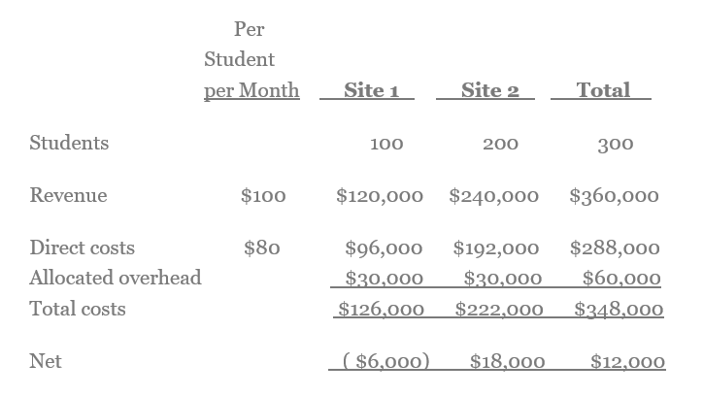
BEFORE

Slide 15
BEFORE

Slide 16
BEFORE

Slide 17
BEFORE

Slide 18
BEFORE

Slide 19
BEFORE

Slide 20
BEFORE

Slide 21
BEFORE

Slide 22
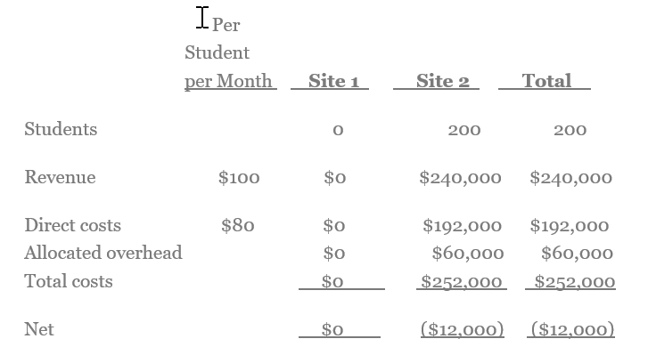
AFTER

Slide 23
AFTER

Slide 24
BEFORE

Slide 25
AFTER

Slide 26
AFTER

Slide 27
Budgeting
#9: Understand your fixed versus variable costs:
be prepared for slow periods, and the next government shutdown!

Slide 28
Cash
#10: Know your Restricted versus Unrestricted funds:
how to manage, and mis-manage, restricted funds.

Slide 29
Cash
#11: Use Rolling Forecasts:
anticipate your cash needs,
before you need the cash.

Slide 30
Cash
#12: Calculate your Reserves:
how much is enough?

Slide 31
Cash
#13: Credit lines and borrowing:
what not to do with a credit line.

Slide 32
Other Topics:
Data Visualization: the power of pictures to tell the story behind the numbers.
Get important information and KPI’s delivered to your smartphones and other mobile devices.
Audits: how to plan, prepare, and work with your auditors.
Internal controls: law of diminishing returns, and why too much of a good thing can be bad.
Charity Watchdogs and “The Overhead Myth” (today’s lunchtime session)
Fraud
New accounting rules

Slide 33
Other Topics:
Data Visualization: the power of pictures to tell the story behind the numbers.
Get important information and KPI’s delivered to your smartphones and other mobile devices.
Audits: how to plan, prepare, and work with your auditors.
Internal controls: law of diminishing returns, and why too much of a good thing can be bad.
Charity Watchdogs and “The Overhead Myth” (today’s lunchtime session)
Fraud
New accounting rules

Slide 34
Other Topics:
Data Visualization: the power of pictures to tell the story behind the numbers.
Get important information and KPI’s delivered to your smartphones and other mobile devices.
Audits: how to plan, prepare, and work with your auditors.
Internal controls: law of diminishing returns, and why too much of a good thing can be bad.
Charity Watchdogs and “The Overhead Myth” (today’s lunchtime session)
Fraud
New accounting rules

Slide 35
Other Topics:
Data Visualization: the power of pictures to tell the story behind the numbers.
Get important information and KPI’s delivered to your smartphones and other mobile devices.
Audits: how to plan, prepare, and work with your auditors.
Internal controls: law of diminishing returns, and why too much of a good thing can be bad.
Charity Watchdogs and “The Overhead Myth” (today’s lunchtime session)
Fraud
New accounting rules

Slide 36
Other Topics:
Data Visualization: the power of pictures to tell the story behind the numbers.
Get important information and KPI’s delivered to your smartphones and other mobile devices.
Audits: how to plan, prepare, and work with your auditors.
Internal controls: law of diminishing returns, and why too much of a good thing can be bad.
Charity Watchdogs and “The Overhead Myth” (today’s lunchtime session)
Fraud
New accounting rules

Slide 37
Other Topics:
Data Visualization: the power of pictures to tell the story behind the numbers.
Get important information and KPI’s delivered to your smartphones and other mobile devices.
Audits: how to plan, prepare, and work with your auditors.
Internal controls: law of diminishing returns, and why too much of a good thing can be bad.
Charity Watchdogs and “The Overhead Myth” (today’s lunchtime session)
Fraud
New accounting rules

Slide 38
Additional resources:
For more information on the topics presented, visit Eric’s blog at: www.EricYPTC.com.

Slide 39
Additional resources:
For more information on the topics presented, visit Eric’s blog at: www.EricYPTC.com.

Slide 40
For help, contact us:

Slide 41
YPTC.COM
For help, contact us:

Slide 42
Questions or Comments?

Slide 43
www.YPTC.com

